Slide 1
Context-Free Languages

Slide 2




Regular Languages

Slide 3
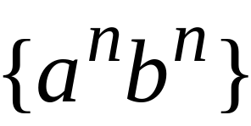
Context-Free Languages
Regular Languages

Slide 4
Context-Free Languages
Context-Free
Grammars
Pushdown
Automata
stack
automaton

Slide 5
Context-Free Grammars

Slide 6


Example
A context-free grammar :
A derivation:

Slide 7
A context-free grammar :
Another derivation:

Slide 8


Describes parentheses:
(((( ))))

Slide 9
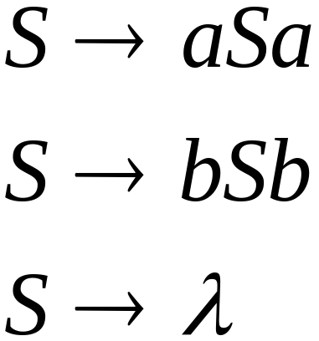
Example
A context-free grammar :
A derivation:

Slide 10
A context-free grammar :
Another derivation:

Slide 11


Slide 12
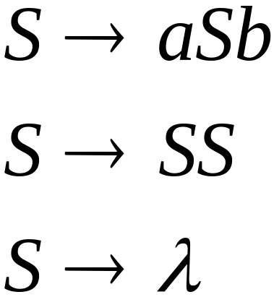
Example
A context-free grammar :
A derivation:

Slide 13
A context-free grammar :
A derivation:

Slide 14
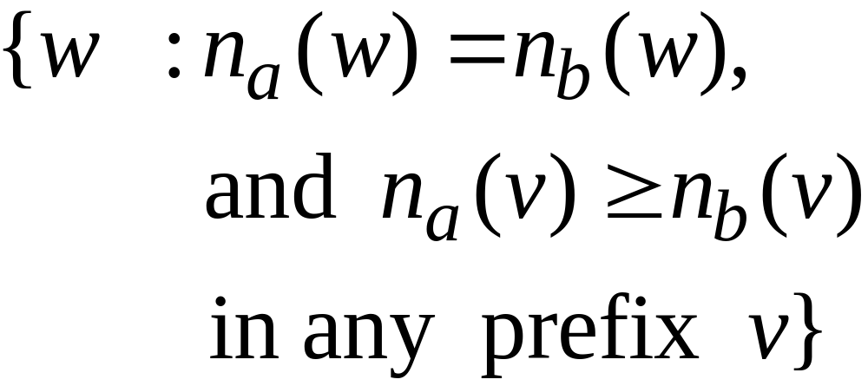
Describes
matched
parentheses:
() ((( ))) (( ))

Slide 15


Definition: Context-Free Grammars
Grammar
Variables
Terminal
symbols
Start
variable
Productions of the form:
Variable
String of variables
and terminals

Slide 16


Slide 17

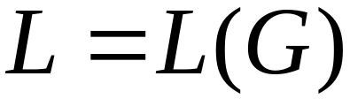
Definition: Context-Free Languages
A language is context-free
if and only if
there is a context-free grammar
with

Slide 18
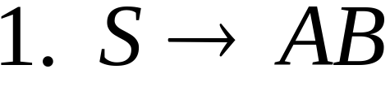
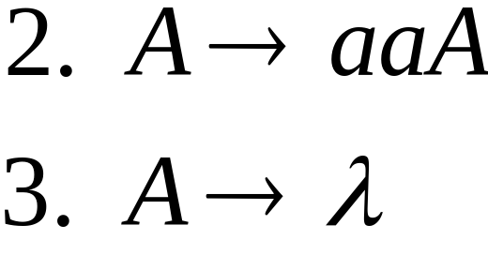
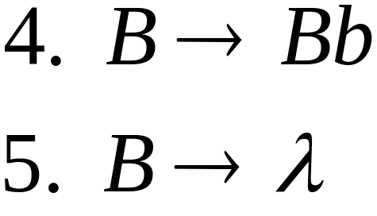


Derivation Order
Leftmost derivation:
Rightmost derivation:

Slide 19
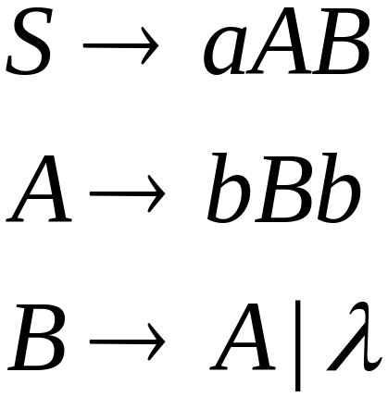
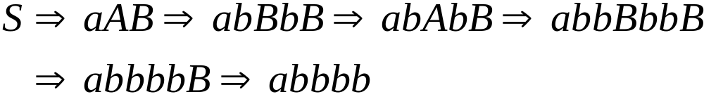
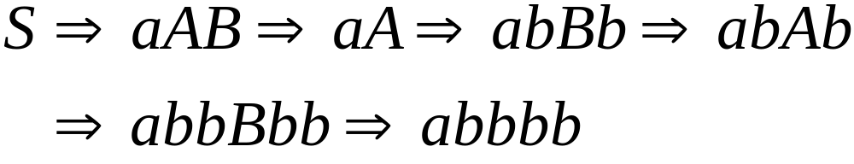
Leftmost derivation:
Rightmost derivation:

Slide 20
Derivation Trees

Slide 21

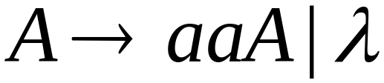
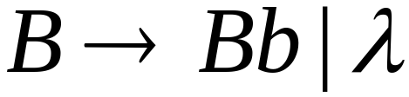





Slide 22



Slide 23


Slide 24


Slide 25
Derivation Tree

Slide 26
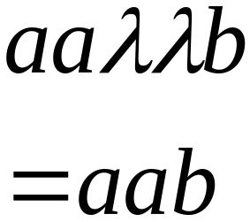
Derivation Tree
yield

Slide 27
Partial Derivation Trees
Partial derivation tree

Slide 28
Partial derivation tree

Slide 29

sentential
form
Partial derivation tree
yield

Slide 30
Sometimes, derivation order doesn’t matter
Leftmost:
Rightmost:
Same derivation tree

Slide 31
Ambiguity

Slide 32





leftmost derivation

Slide 33

leftmost derivation

Slide 34
Two derivation trees

Slide 35
The grammar
is ambiguous:
string
has two derivation trees

Slide 36
The grammar
is ambiguous:
string
has two leftmost derivations

Slide 37

Definition:
A context-free grammar is ambiguous
if some string has:
two or more derivation trees

Slide 38
In other words:
A context-free grammar is ambiguous
if some string has:
two or more leftmost derivations
(or rightmost)

Slide 39

Why do we care about ambiguity?
take

Slide 40



Slide 41






Slide 42
Correct result:

Slide 43
Ambiguity is bad for programming languages
We want to remove ambiguity

Slide 44
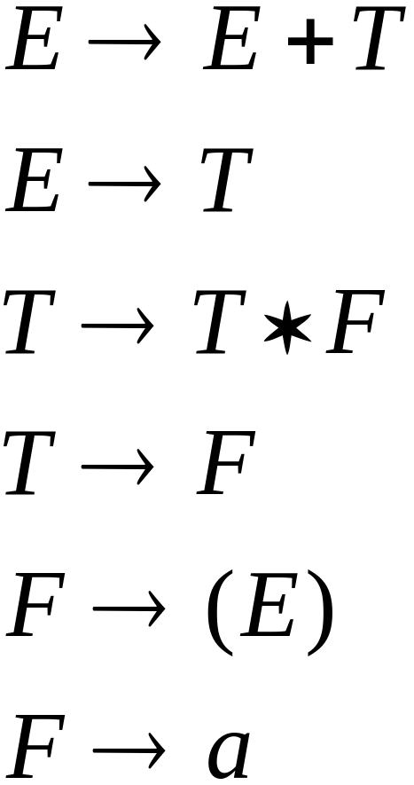
We fix the ambiguous grammar:
New non-ambiguous grammar:

Slide 45




Slide 46
Unique derivation tree

Slide 47
The grammar :
is non-ambiguous:
Every string has
a unique derivation tree

Slide 48

Another Ambiguous Grammar
IF_STMT
if EXPR then STMT
if EXPR then STMT else STMT

Slide 49
If expr1 then if expr2 then stmt1 else stmt2
IF_STMT
if
expr1
then
STMT
if
expr2
then
stmt1
else
stmt2
IF_STMT
if
expr1
then
STMT
else
stmt2
if
expr2
then
stmt1

Slide 50
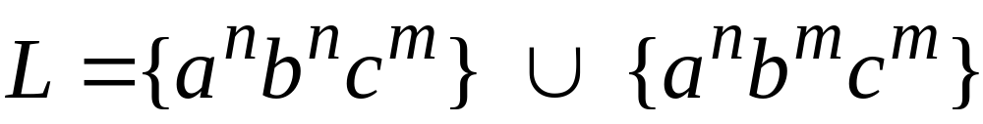

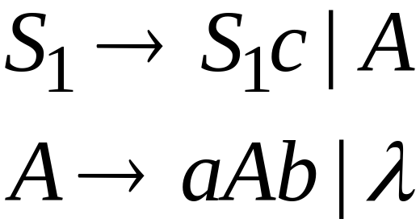
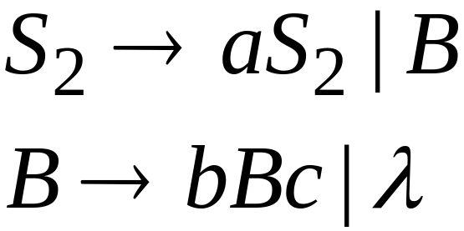
Inherent Ambiguity
Some context free languages
have only ambiguous grammars
Example:

Slide 51
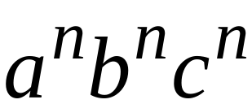



The string
has two derivation trees

Slide 52
Compilers

Slide 53
Machine Code
Program
Add v,v,0
cmp v,5
jmplt ELSE
THEN:
add x, 12,v
ELSE:
WHILE:
cmp x,3
...
v = 5;
if (v>5)
x = 12 + v;
while (x !=3) {
x = x - 3;
v = 10;
}
......
Compiler

Slide 54
Compiler
Lexical
analyzer
parser
input
output
machine
code
program

Slide 55
A parser knows the grammar
of the programming language

Slide 56

Parser
PROGRAM STMT_LIST
STMT_LIST STMT; STMT_LIST | STMT;
STMT EXPR | IF_STMT | WHILE_STMT
| { STMT_LIST }
EXPR EXPR + EXPR | EXPR - EXPR | ID
IF_STMT if (EXPR) then STMT
| if (EXPR) then STMT else STMT
WHILE_STMT while (EXPR) do STMT

Slide 57
The parser finds the derivation
of a particular input
derivation
Parser
input
E => E + E
=> E + E * E
=> 10 + E*E
=> 10 + 2 * E
=> 10 + 2 * 5
E -> E + E
| E * E
| INT
10 + 2 * 5

Slide 58
derivation tree
derivation
E
E => E + E
=> E + E * E
=> 10 + E*E
=> 10 + 2 * E
=> 10 + 2 * 5
+
E
E
10
E
*
E
2
5

Slide 59
derivation tree
E
machine code
E
+
E
mult a, 2, 5
add b, 10, a
10
E
*
E
2
5

Slide 60
Parsing

Slide 61
Parser
input
string
grammar
derivation

Slide 62
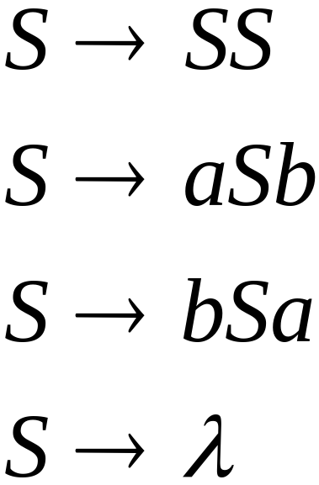

Example:
Parser
derivation
input
?

Slide 63
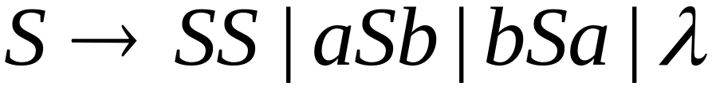
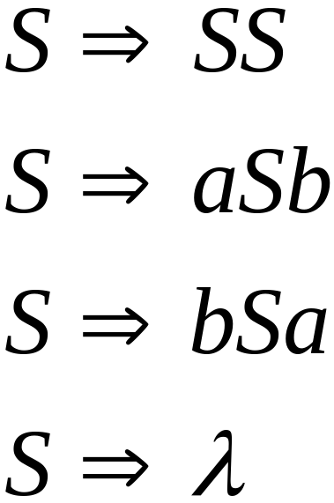
Exhaustive Search
Phase 1:
Find derivation of
All possible derivations of length 1

Slide 65
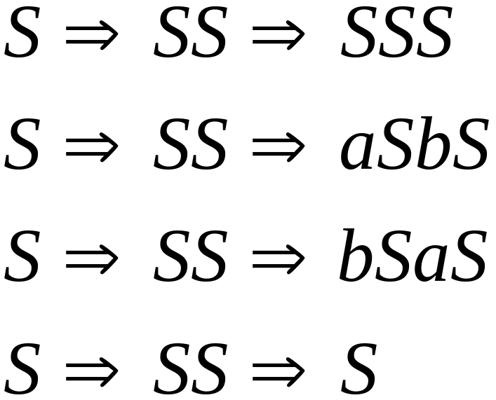
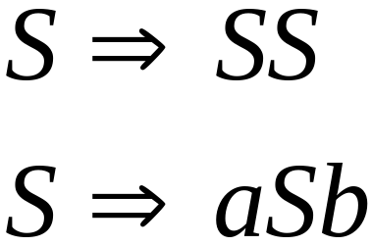
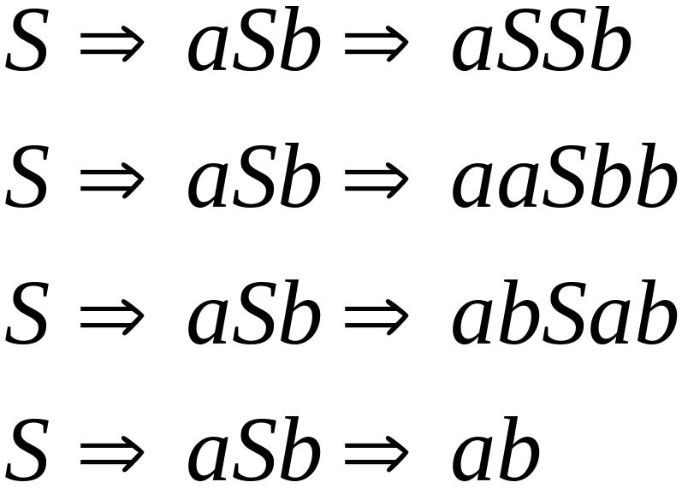
Phase 2
Phase 1

Slide 66
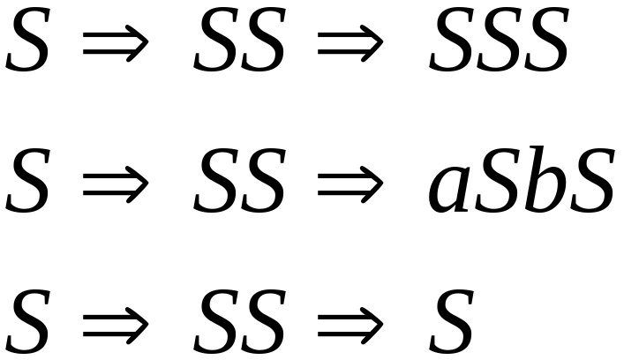
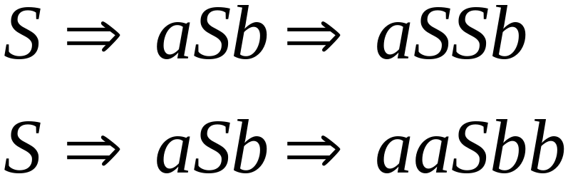
Phase 2
Phase 3

Slide 67
Final result of exhaustive search
(top-down parsing)
Parser
input
derivation

Slide 68


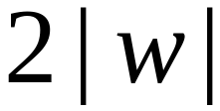

Time complexity of exhaustive search
Suppose there are no productions of the form
Number of phases for string :

Slide 69


For grammar with rules
Time for phase 1:
possible derivations

Slide 70
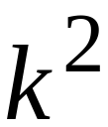
Time for phase 2:
possible derivations

Slide 71
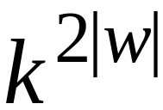
Time for phase :
possible derivations

Slide 72
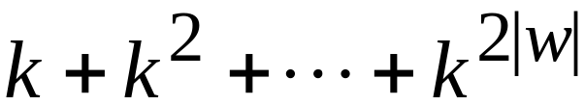
Total time needed for string :
phase 1
phase 2
phase 2|w|
Extremely bad!!!

Slide 73

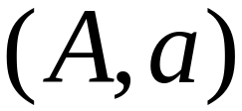
There exist faster algorithms
for specialized grammars
S-grammar:
symbol
string
of variables
Pair
appears once

Slide 74
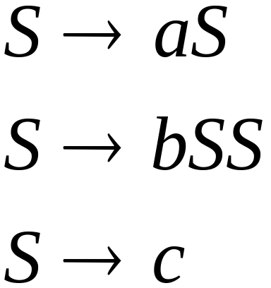
S-grammar example:
Each string has a unique derivation

Slide 75


For S-grammars:
In the exhaustive search parsing
there is only one choice in each phase
Time for a phase:
Total time for parsing string :

Slide 76

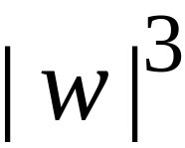
For general context-free grammars:
There exists a parsing algorithm
that parses a string
in time
(we will show it in the next class)

